Slide 1

Notasi – Structure Diagram
PROGRAM STUDI TEKNIK INFORMATIKA
MATA KULIAH
Object Oriented
Analysis and Design
TEKNIK INFORMATIKA S1
UNIVERSITAS DIAN NUSWANTORO
2021

Slide 2
Capaian Pembelajaran
Mahasiswa mampu menjelaskan dasar unified modeling language dan structure diagram

Slide 3
Tujuan Pembelajaran
Mahasiswa dapat menjelaskan konsep relasi class dalam structure diagram

Slide 4
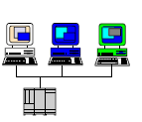
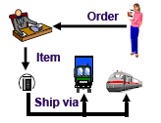

Why Modeling ?
Business Process
Computer System
Modeling capture important part of system (James Rumbaugh)

Slide 5
Unified Modeling Language
UML is a modeling language, not methodology or process
UML is modeling language for visualizing, specifying, constructing, and documenting the artifacts of software systems
Notation called UML is important for documenting object-oriented system (Brahma Dathan, Sarnath Ramnath)
UML provides a pictorial and graphical notation for documenting the artifacts such as classes, objects, and packages that make up an OO systems

Slide 6
Unified Modeling Language
Visualizing
A graphical notation articulates and unambiguously
Communicates the overall view of the system(problem-domain)
Specifying
UML provides the means to model precisely, unambiguously and completely the system in question

Slide 7
Unified Modeling Language
Constructing
Model built with UML have a “design” dimension
Documenting
Every software project involves a lot of documentation – from the inception phase to the deliverables

Slide 8
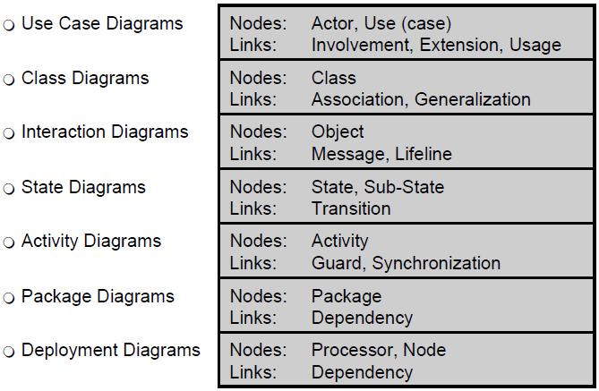
UML Diagrams

Slide 9
UML Diagrams
Class Diagrams
Diagram shows a set of classes, interfaces, collaborations and their relationships. Models the static view of the system
Object diagram
Snapshot of a class diagram; models the instances of things contained in a class diagram
Use case diagram
Shows a set of “use cases”, the actor and their relationships
What the system is expected to do

Slide 10
UML Diagrams
Sequence Diagram
Models the flow of control by time-ordering, depicts the interaction between various objects by of messages passed, with a temporal dimension to it
Collaboration diagram
Models the interaction between objects, without the temporal dimension; depict the messages passed between objects
Statechart diagram
Shows the different state machines and the events that leads to each of these state machines

Slide 11
UML Diagrams
Activity Diagram
Shows the flow from activity to activity; an “activity” is an ongoing non-atomic execution within a state machine
Component Diagram
Shows the physical packaging of software in terms of components and the dependencies between them
Deployment Diagram
Shows the configuration of the processing nodes at run-time and the components that live on them

Slide 12
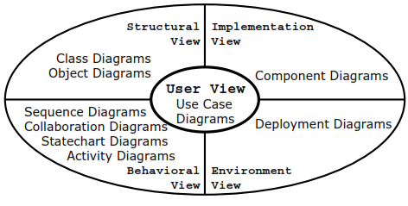
Dimensions

Slide 13
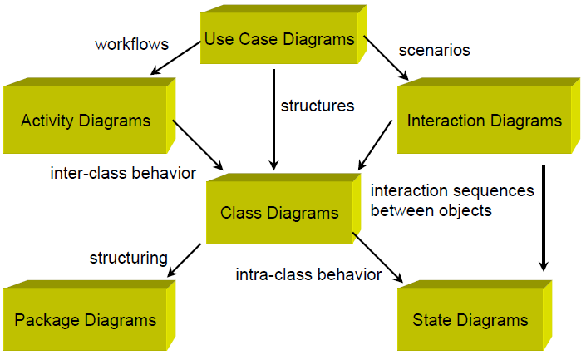
UML Diagrams

Slide 14
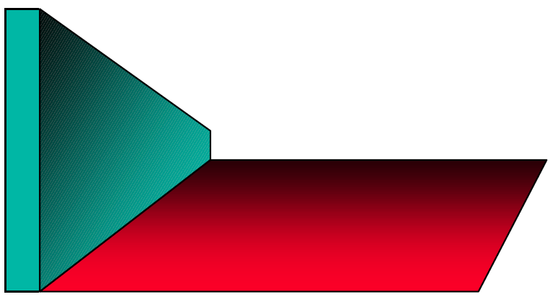
Diagrams and Process

Slide 15
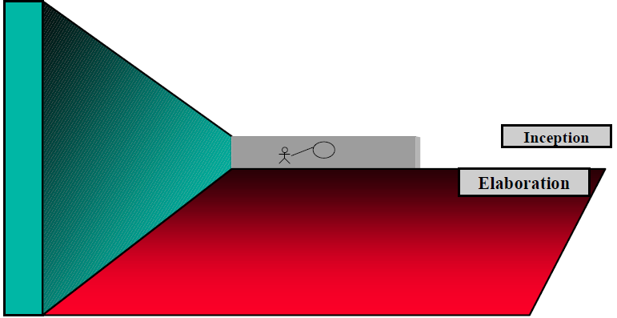
Diagrams and Process
Use Case Diagrams

Slide 16
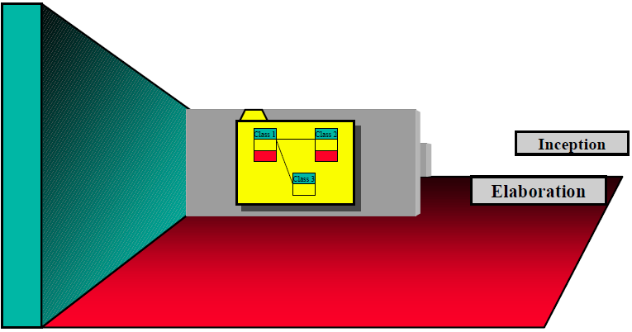
Diagrams and Process
Class & Package Diagrams

Slide 17
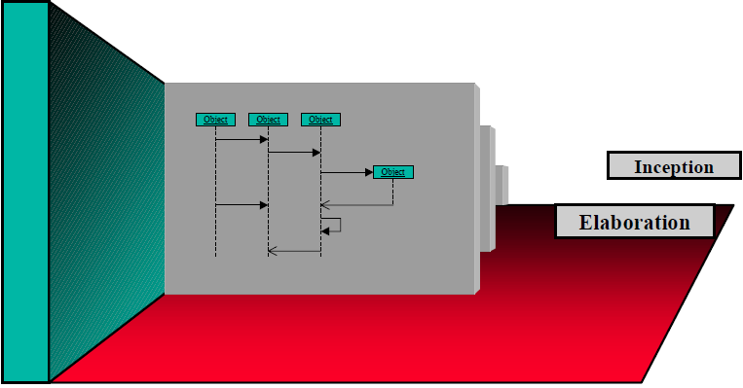
Diagram and Process
Interaction Diagrams (Scenarios)

Slide 18
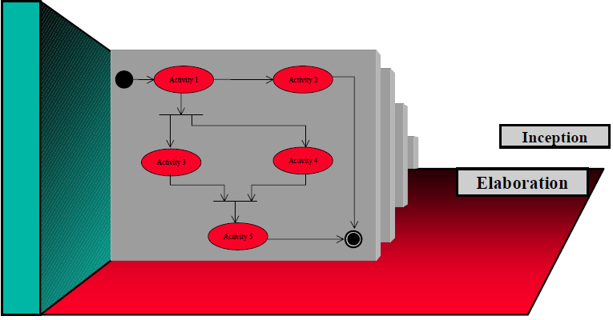
Diagram and Process
Activity Diagrams (Workflow, Interclass Behavior)

Slide 19
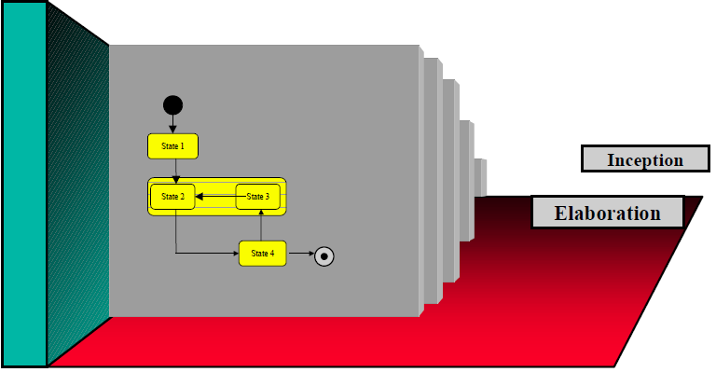
Diagrams and Process
State Transition Diagrams (Intraclass Behavior)

Slide 20
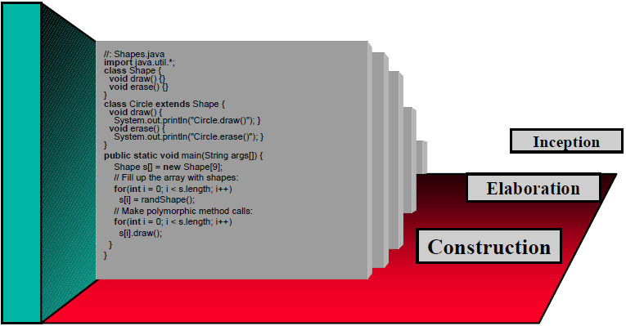
Texts and Process
Source Code

Slide 21
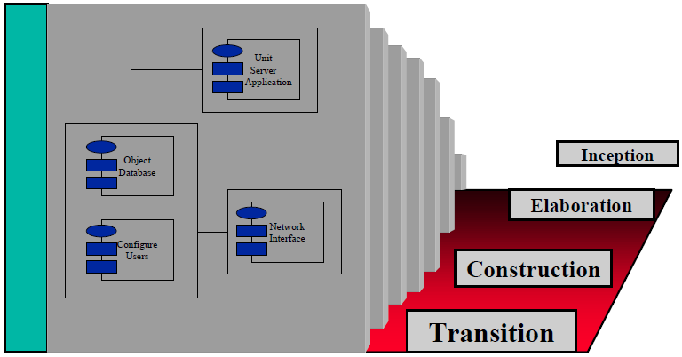
Diagrams and Process
Deployment Diagrams

Slide 22
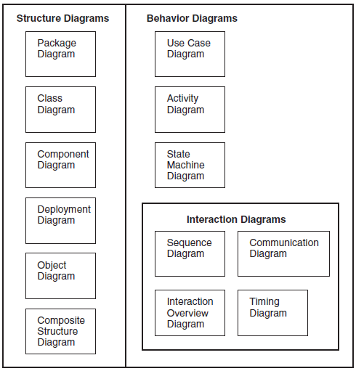
Unified Modeling Language
UML diagrams can be divided into three categories :
Structure diagrams
Behavior diagrams
Interaction diagrams

Slide 23
Structure Diagrams
Structure diagrams show the static architecture of the system irrespective of time
Structure diagram may depict:
The architectural organization of the system
The physical elements of the system
Example :
Structure diagram for a university system
Diagram depict of classes such as student, faculty

Slide 24
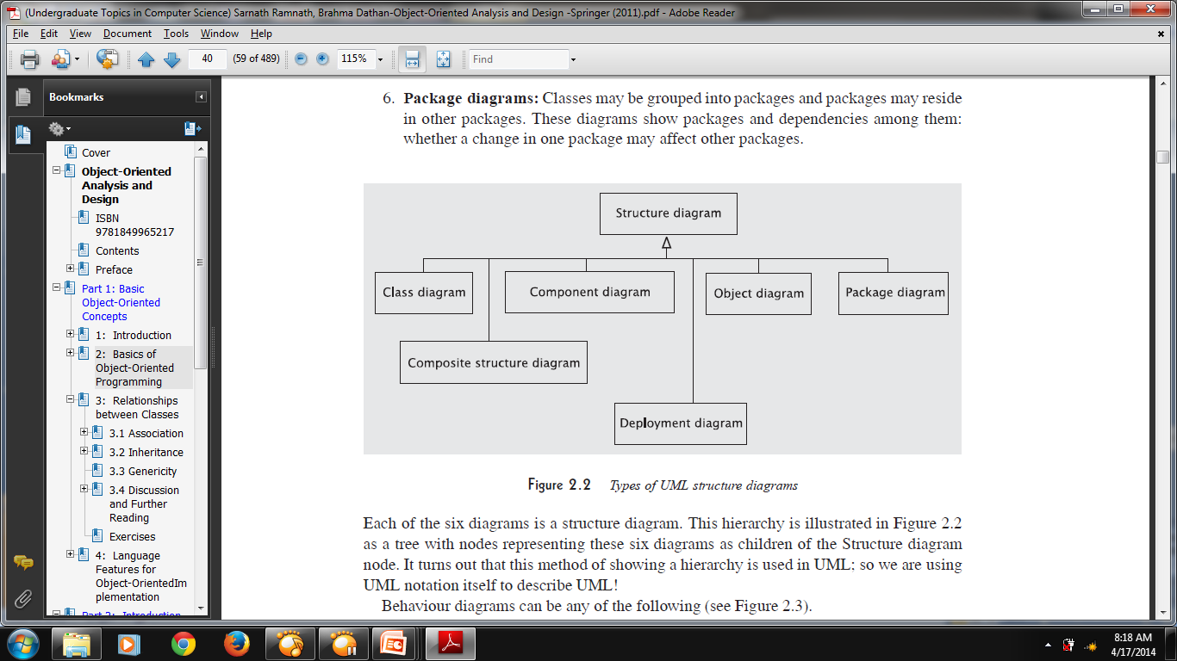
Structure Diagrams
Package Diagram
Class Diagram
Component Diagram
Deployment Diagram
Object Diagram
Composite Structure Diagram

Slide 25
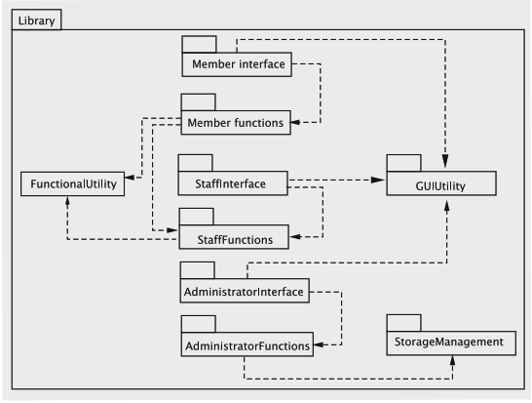
Package Diagram
Classes may be grouped into packages and packages may reside in other packages
These diagram show packages and dependencies among them
- Whether a change in one package may affect other packages

Slide 26
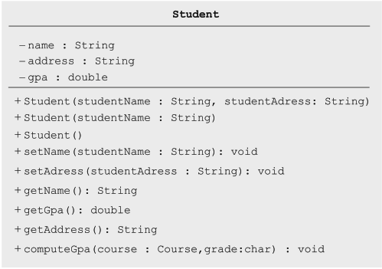
Class Diagram
Class diagram show the classes, their methods and fields
Each class is represented by a box, which is divided into three rectangles:
The first box: name of class
The second box: attribute and type
The third box: method

Slide 27
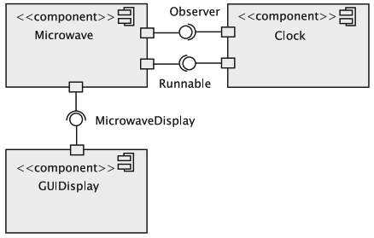
Component Diagram
Components are software entities that satisfy certain functional requirements specified by interfaces.
These diagrams show the details of components
The relationship between provided and required interfaces helps the reader understand the design better

Slide 28
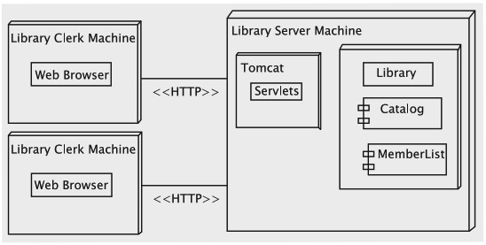
Deployment Diagram
An object-oriented system consist of a number of executable file sometimes distributed across multiple computing elements
The diagram show the assignment of executable files on the computing elements and the communication that involves between these entities
In other word, the deployment diagram depicts the configuration of the finished product

Slide 29
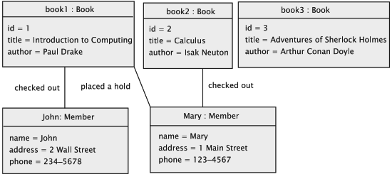
Object Diagram
Object diagram used to show how objects are related and used at runtime
An instantiation of class diagram
Allow you to think of concrete objects, rather than abstract classes

Slide 30
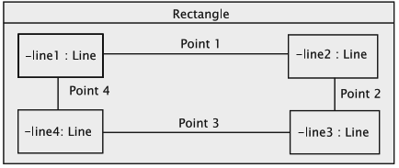
Composite Structure Diagram
Composite structure diagram provide the details of a structural element such as a class
The composite structure diagram for such a system would show these parts and exhibit the relationship between them helping the reader understand the details
For example: rectangle contains 4 lines. Each of the four lines that is an edge of the rectangle is intuitively a paprt of the rectangle object

Slide 31
Referensi
Grady Booch, Robert A. Maksimchuk, Michael W. Engle, Bobby J.Young, Jim Conallen, Kelli A. Houston, Object Oriented Analysis and Design, 2011, Springer, Universities Press
Brahma Dathan, Sarnath Ramnath, Undergraduate Topics in Computer Science: Object Oriented Analysis and Design with Application 2nd edition, 2007, Springer:Universities Press

Slide 32

TERIMA KASIH
ANY QUESTIONS?

